Slide 1
Health Equity OKR 2021: Establishing Baseline Measures
July 27, 2021
Leo Zhou

Slide 2
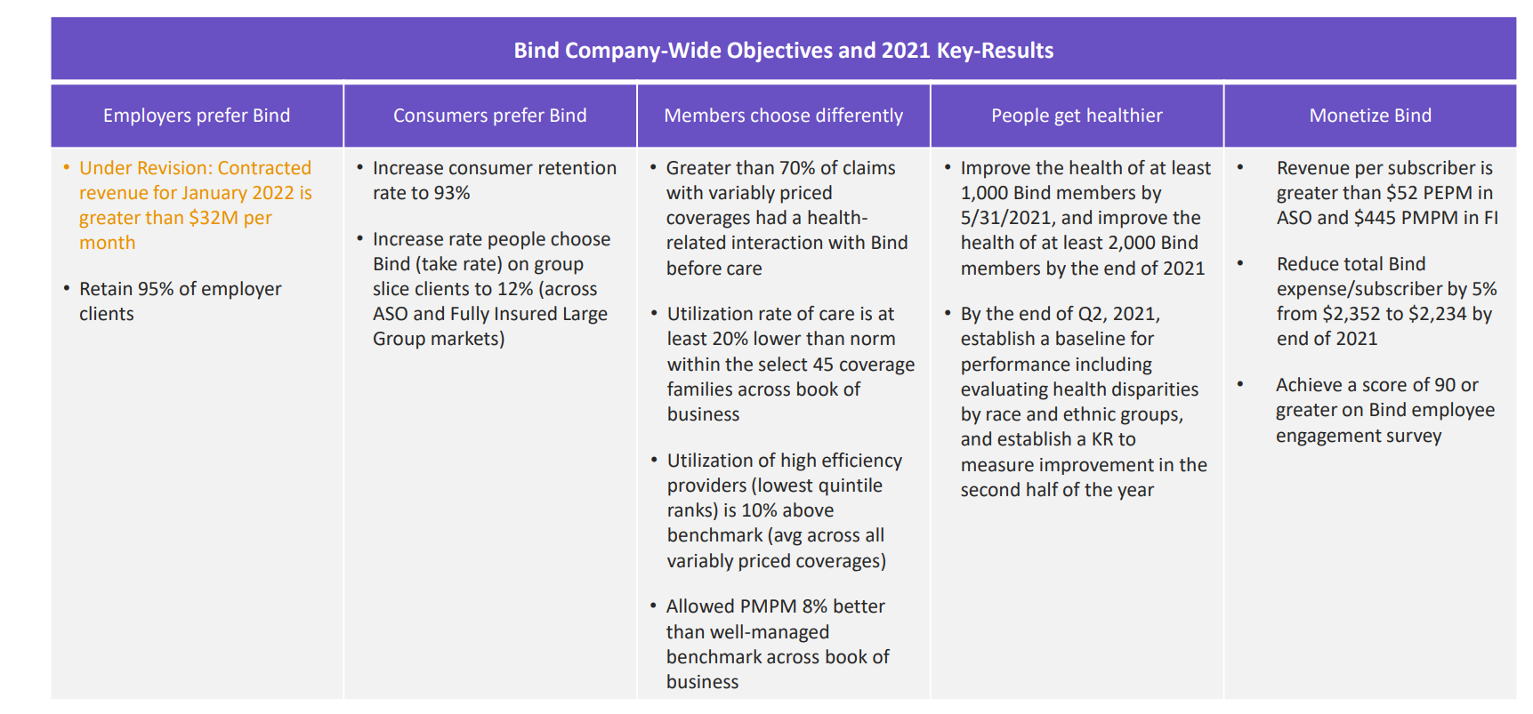
Goal: determine the baseline differences in compliance with evidence-based guidelines for Bind members by race and ethnicity. This will inform our 2022 OKR and identify targeted opportunities to reduce differences in appropriate healthcare use across our members.

Slide 3
Background
One area of quality measurement focuses on evidence-based measures (EBM) standards. Milliman provides us with over 350 standards applied to claims data and as defined by NQF, HEDIS and other sources
A subset of these standards focus on the following – both types have cascading effects downstream
Overuse: services that represent aspects of waste or often unnecessary care
Underuse: services that are often vulnerable to lower levels of use even though best practice standards have been established
For every measure, we can calculate a “rate” which considers:
Denominator: members who met the criteria for a given measure (ex. Minimum length of enrollment)
Numerator: members who then received the service
We also include the University of Wisconsin Neighborhood Deprivation Index (NDI) in our models
Rankings of neighborhoods (census block groups) by socioeconomic disadvantage in a region of interest. Range 1 – 100 (least disadvantaged - most disadvantaged )
Finally, we use “predicted race” based on a number of data sources and models
Time frame: Jan 2019 – April 2021
Unit of observation: service-member combination
Notes:
Ebm: represent various delivery systems and care settings
Overuse ex:

Slide 4
National Deprivation Index - summary
Correlation | Age
NDI | 0.12
Predicted race/ethnicity | Average NDI
White | 37
Hispanic | 46
Black | 61
AIAN | 57
Weak positive correlation
Gender | Average NDI
Male | 37
Female | 41

Slide 5
R output

Slide 6
Thank you!

